Slide 1
THE SCIENCE OF BLACKSMITHING
Gaspar Lesznik
Artist - Blacksmith - Engineer
AU 2019

Slide 2
Disclaimer
I don’t shoe horses.
Farriers shoe horses.
All Farriers are Blacksmiths.
Not all Blacksmiths are Farriers.

Slide 3
Topics
Traditional Blacksmithing
The Raw Material - Steel = Iron + Carbon
Steel – the tough stuff
Blacksmithing Equipment
Forging
Temperatures and Physical State
Moving Metal - Physical and Mechanical
Heat Treatment
Forge Welding

Slide 4
Traditional Blacksmithing
A blacksmith makes tools and other objects out of metal by heating it and using force to bend, twist and otherwise shape the material.
Before the Industrial Revolution (~1760 to 1840) the blacksmith was your local “factory” to make just about everything made of metal. Nails, chains, plows, pots, knives, chisels, hinges, latches, kitchen utensils, chains, etc.
Tools for all the Trades.
Traditional blacksmithing – how it has been done for thousands of years up until the industrial revolution (~1750 AD). (my definition)

Slide 5
The Raw Material: Steel = Iron + Carbon
Iron (Fe) – Latin: ferrum
by mass is the most abundant element on earth, just ahead of oxygen, 32.1% and 30.1% respectively
Extracted from ores found on earths crust and surface
Melts at ~2,750ºF where it is separated from other minerals present
Relatively soft and malleable, dense
Carbon (C) – Latin: carbo (coal)
Abundant in nature in many forms: coal, diamond, burnt toast…..
A building block of life. Without carbon life as we know it would not exist.

Slide 6
Steel - the tough stuff
Steel is a solid solution of iron and carbon. The carbon is dissolved in the iron. Iron is the solvent and carbon is the solute.
In 2020 the world produced 1,878 million tons of steel.
Infinitely recyclable.
There are over 3,500 grades of steel broken down into 4 categories
Carbon steel (90% of all steel produced).
Alloy steel
Tool steel
Stainless steel

Slide 7
Steel – the tough stuff
Carbon Steel = Fe (~99%) + C (~<1%)
Mild (Low Carbon) Steel: C = < 0.25%
Inexpensive, the most abundant steel used globally (~90%). It is used in everything that does not require superior strength or durability.
Can not be hardened. Can not hold a sharp edge.
Piping, fencing, ornamental, wide range of structural applications (bridges)….
Medium Carbon Steel: C = 0.25 – 0.55%
Can be hardened.
Railroad tracks, machinery parts, pressure vessels, cranks…..
High Carbon Steel: C = 0.55 – 0.99%
Maximum strength and hardness, low ductility.
Knives, chisels, punches, spring steel, cutters, ………

Slide 8
Steel – the tough stuff
Alloy Steels
Contain one or more alloying elements (nickel, manganese, titanium, copper, silicon, chromium, molybdenum, cobalt, tungsten, vanadium, and aluminum) to obtain various steel properties for different applications.
Hardenability, corrosion resistance, strength, formability, weldability, or ductility can be improved.
More expensive than carbon steels. Widely available.
Thousands of variations.
Tool Steels
A subset of alloy steels derived for material toughness, high hardness, abrasion resistance, heat resistance.
Machine tools, hammers, molds, dies, cutters…………
Stainless Steels
Up to 20% chrome and 10% nickel. Corrosion resistant, sanitary, aesthetic…..

Slide 9
Steel – the tough stuff
The carbon content determines the maximum obtainable hardness of the steel
Heat treatment determines the actual hardness and flexibility
How steel is heated and cooled will dictate whether the given steel will shatter, bend, or flex.
Heat affects the growth and arrangement of the steel’s crystalline structure
Wrought Iron
An iron alloy with <0.02% carbon and ~2% other impurities (slag)
Used throughout history but replaced by advanced steelmaking methods
No longer commercially available, last foundries shut down in the 1970’s

Slide 11
Steel – the tough stuff
Junkyard Steels (my choice)
Used and abused and discarded steel of an unknown grade (and quality)
Widely available and cheap, often free
Infinite possibilities
Tool steel: Automobile springs (coil and leaf); axles, bed frames, saw blades, farm machinery, sucker rod, garage door springs…..
Carbon steel: Wrecking bars, fences, machinery parts and housings…..

Slide 12
Testing Junkyard Steel for Carbon
Consider original use
Spark test
Low or no carbon steels have dull sparks
Medium and high carbon steels are bright and explosive sparks

Slide 13
Blacksmith Equipment - the Forge
Hearth or forge to heat metal.
Target high temperature from 1,700º to 2,300ºF.
Usually constructed of cast iron, steel, brick and mortar
Must have forced air (oxygen). Blower, fan, bellows…..
Fuel
Coal (clean bituminous is best). Widely available. Efficient and inexpensive.
Wood, charcoal can be used but very inefficient.
Propane
Delivery of air (oxygen) is essential for a hot fire

Slide 14
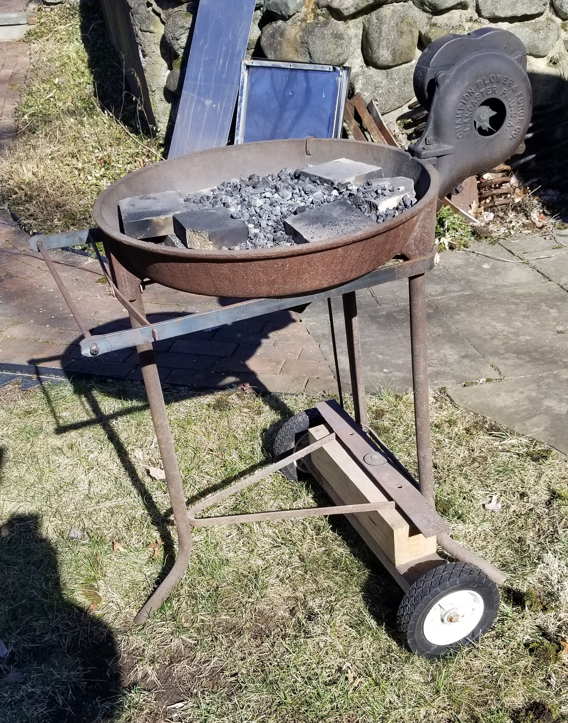
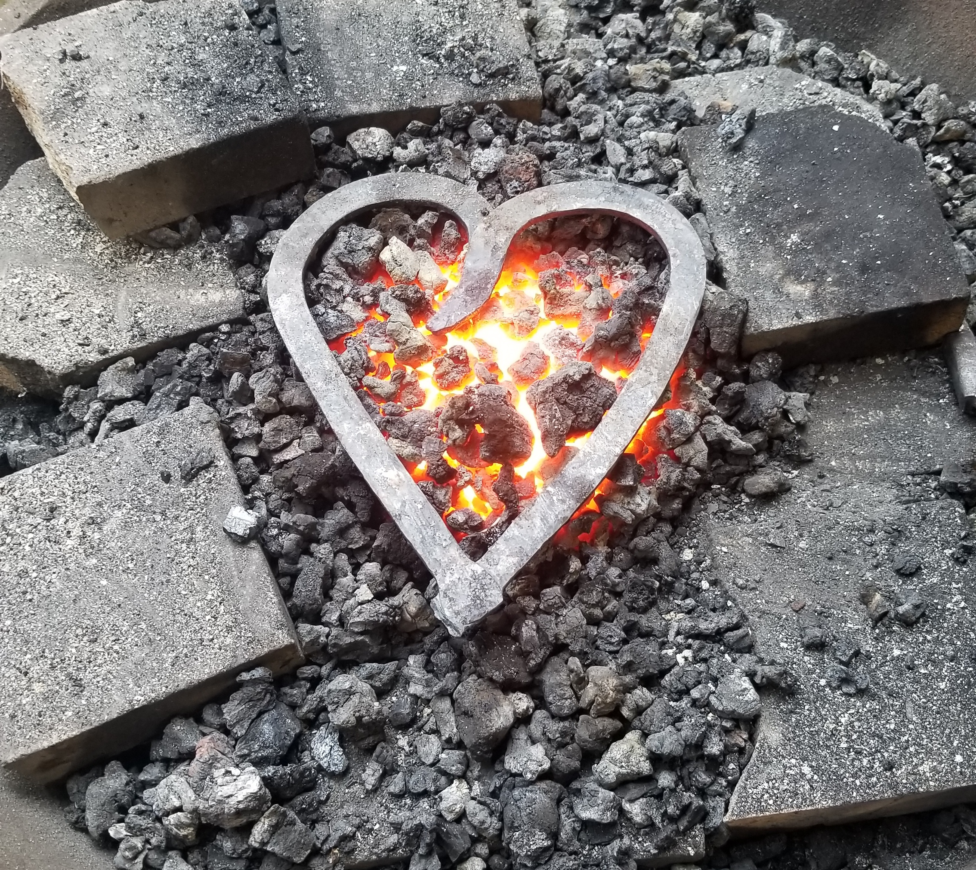

Slide 15
Blacksmith Equipment – the Anvil
Anvil (the soul of the smithy)
Acts as a mold, platform and third hand to shape the metal
Accepts various tooling for cutting, twisting, holding, etc.
Must have mass
Traditional anvils are expensive (~$7 - $9 per pound)
Any heavy metal block can work to degree
Accessories
Vice, quench bucket(s), hammers, tongs, hand tools

Slide 16
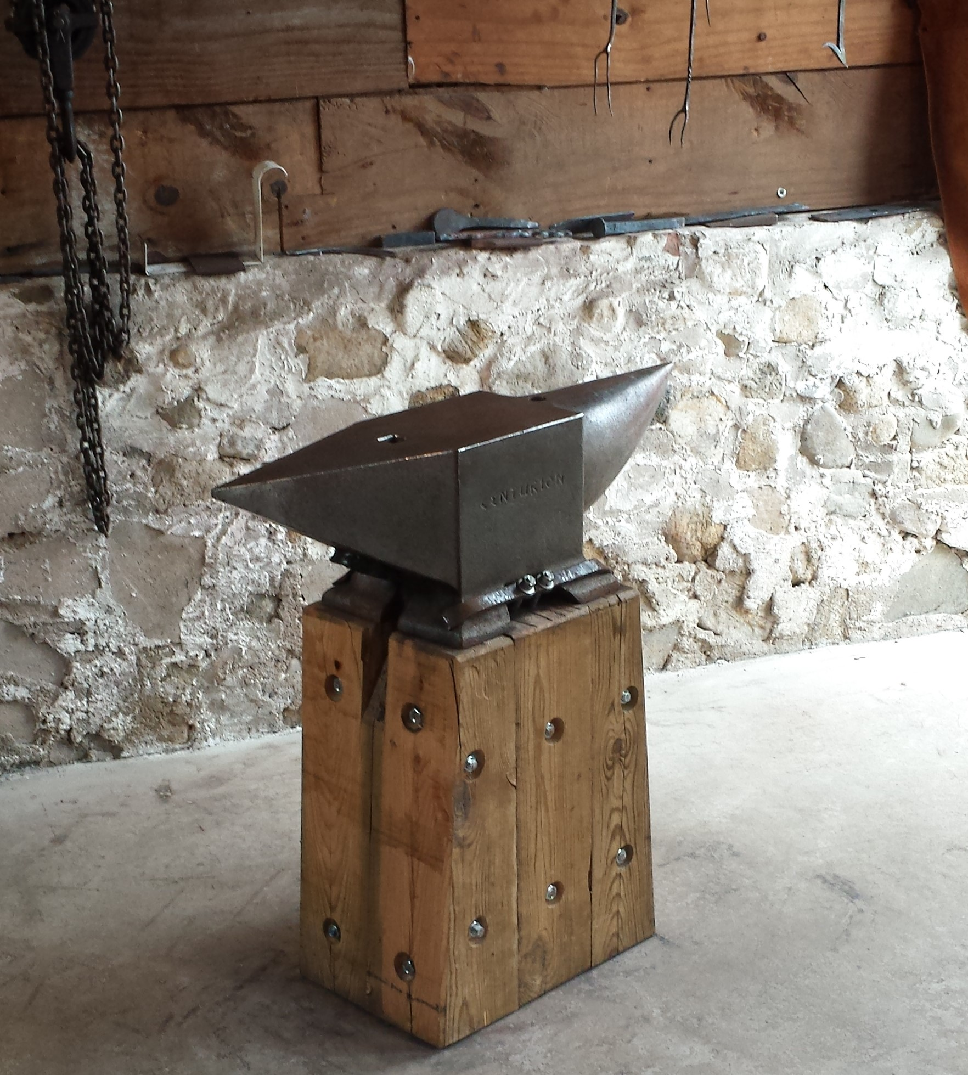
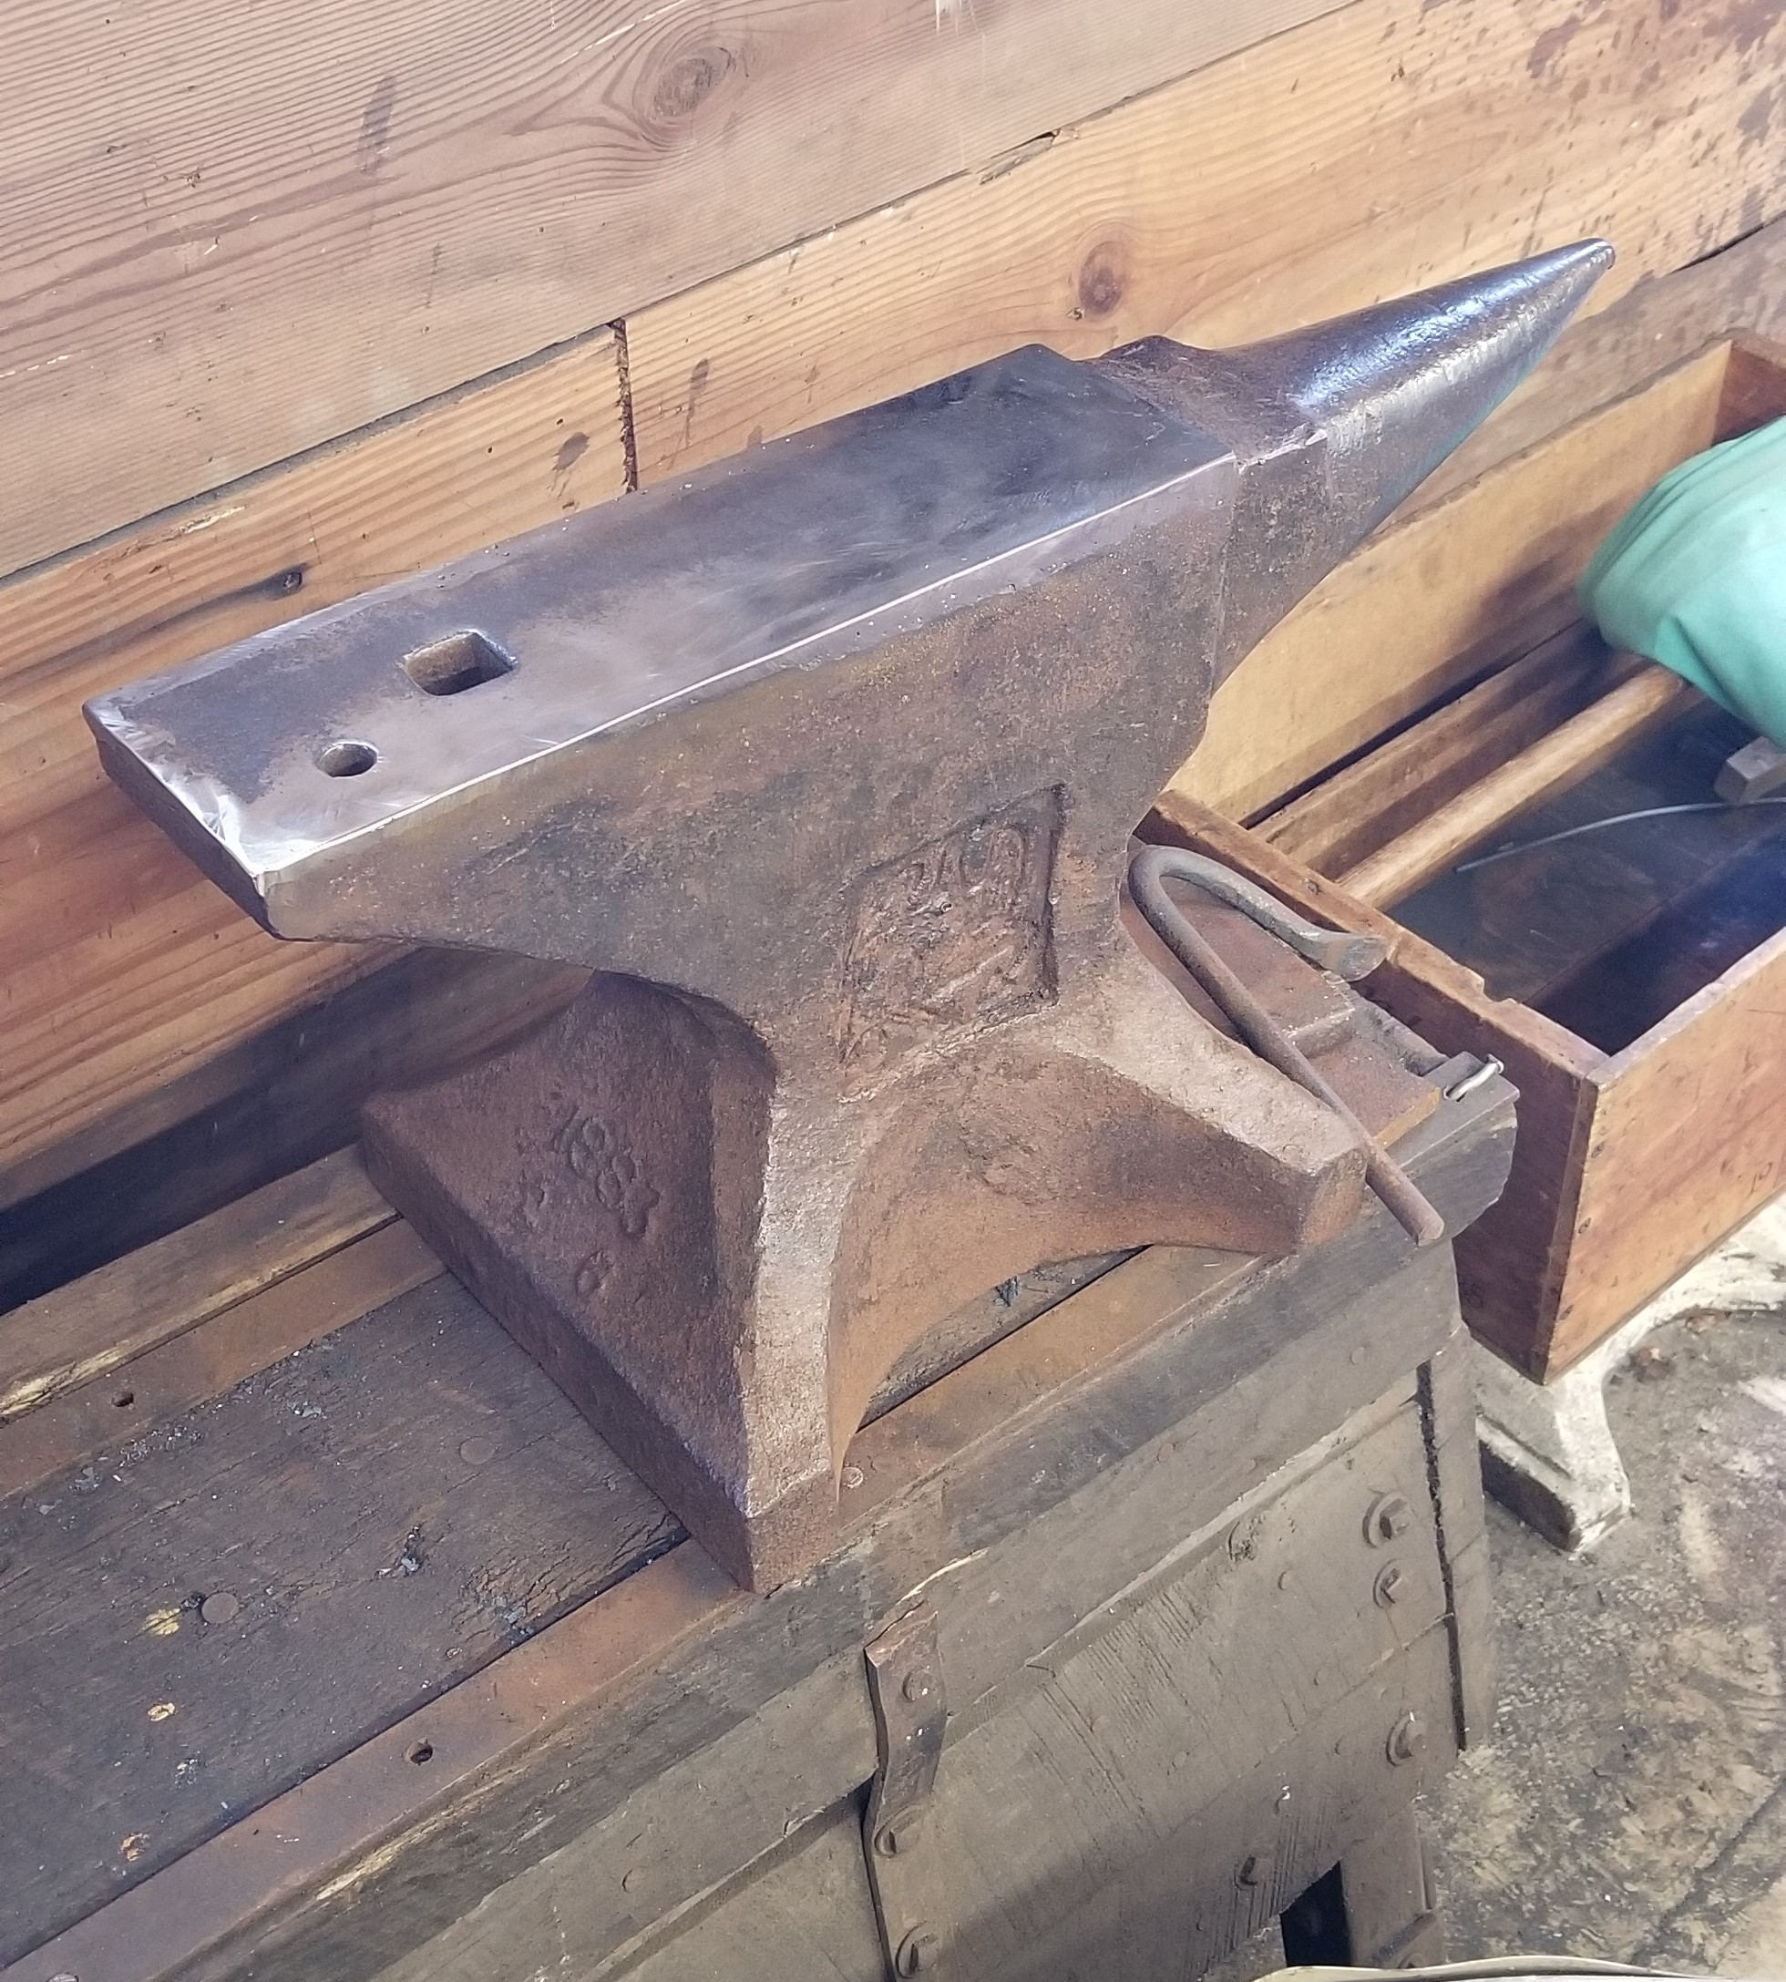
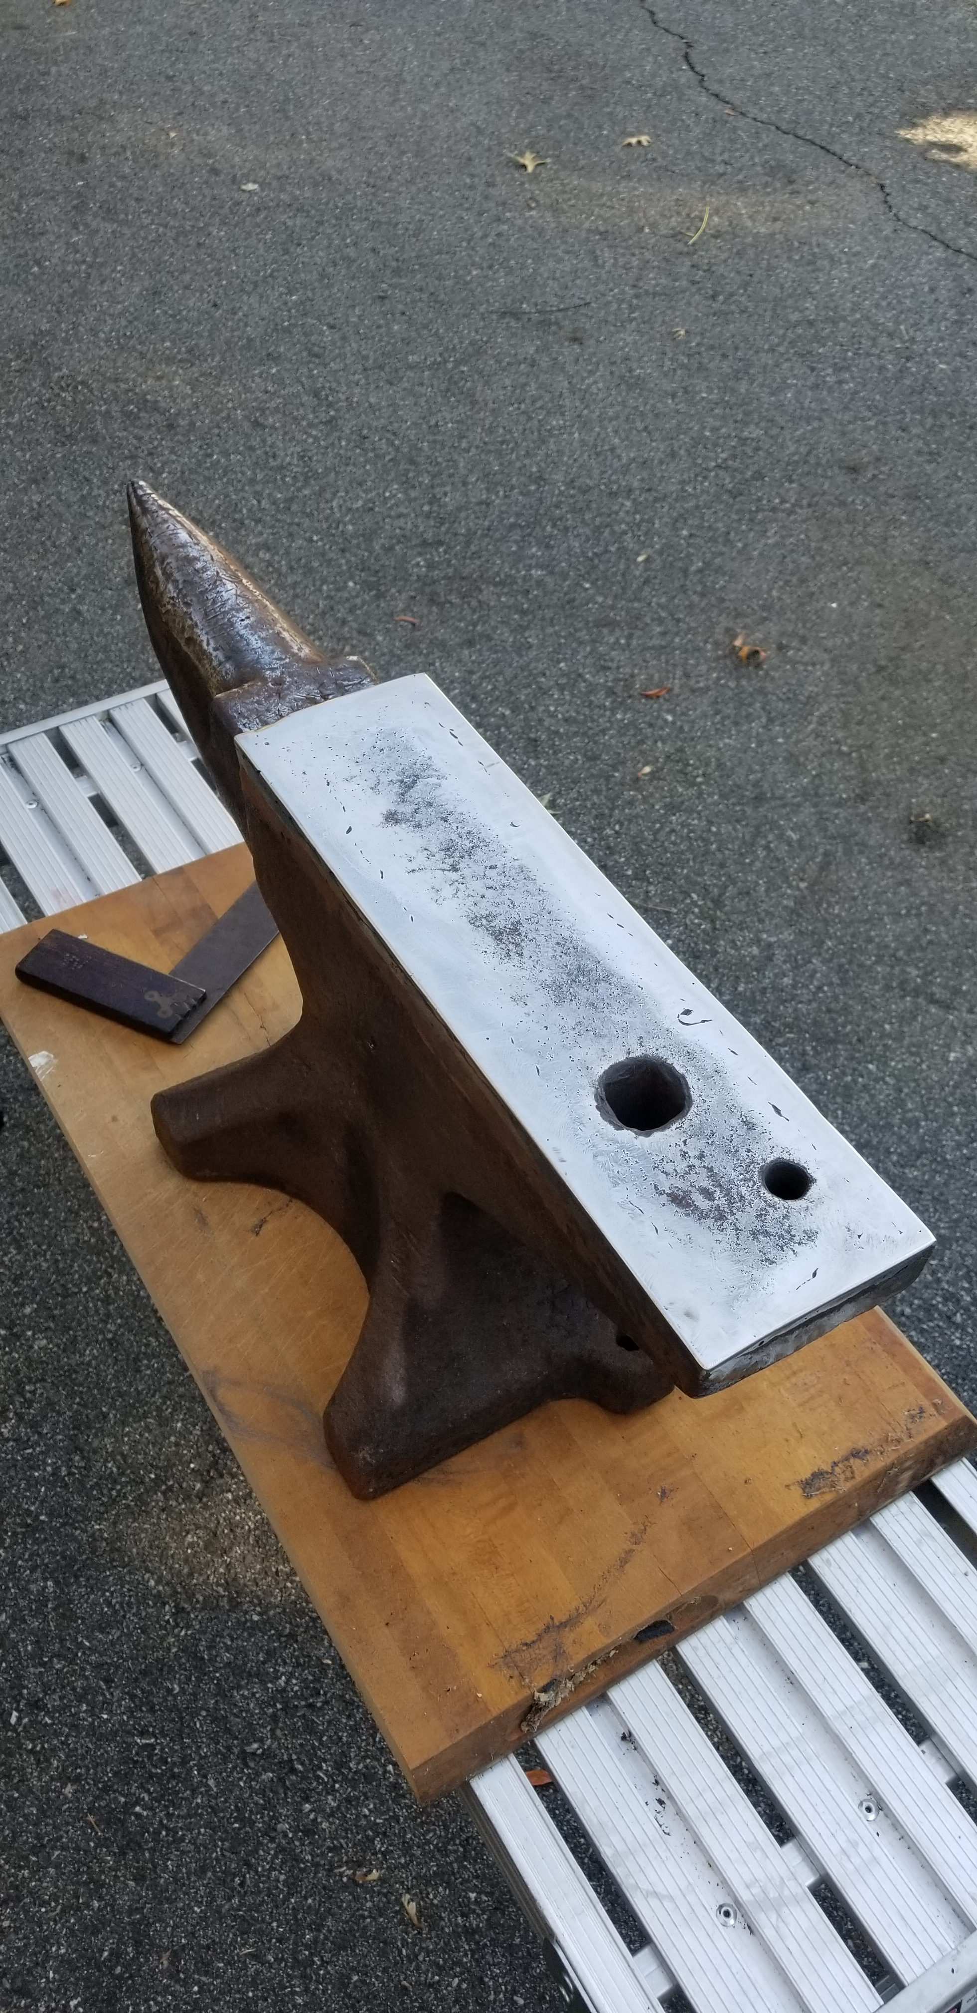

Slide 17
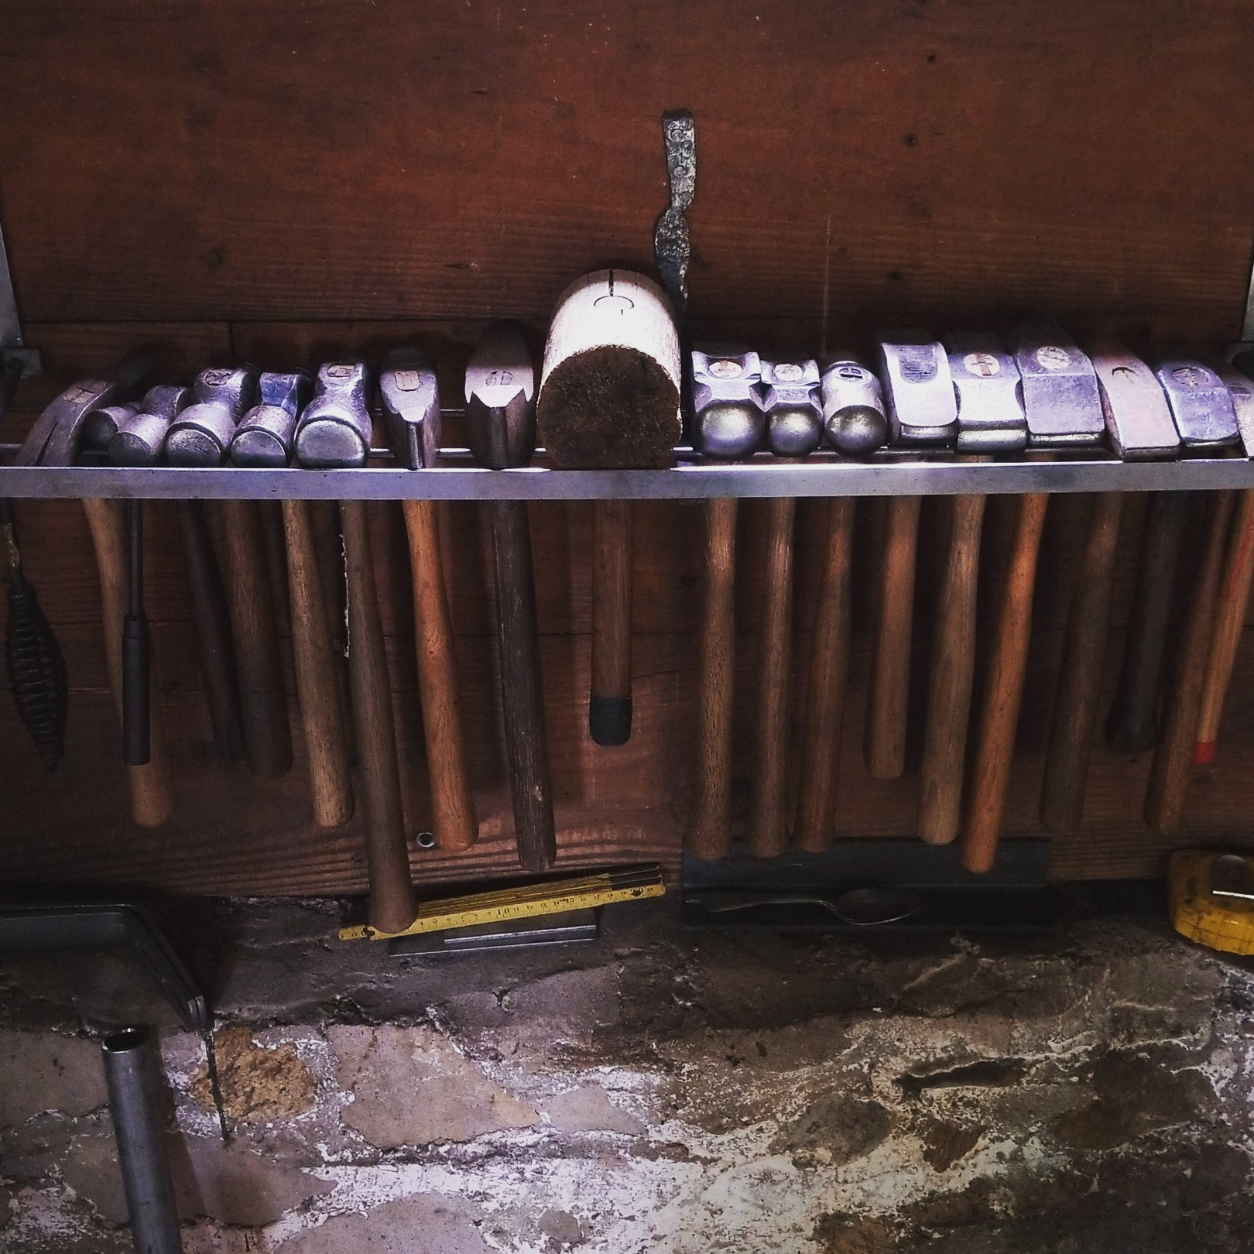
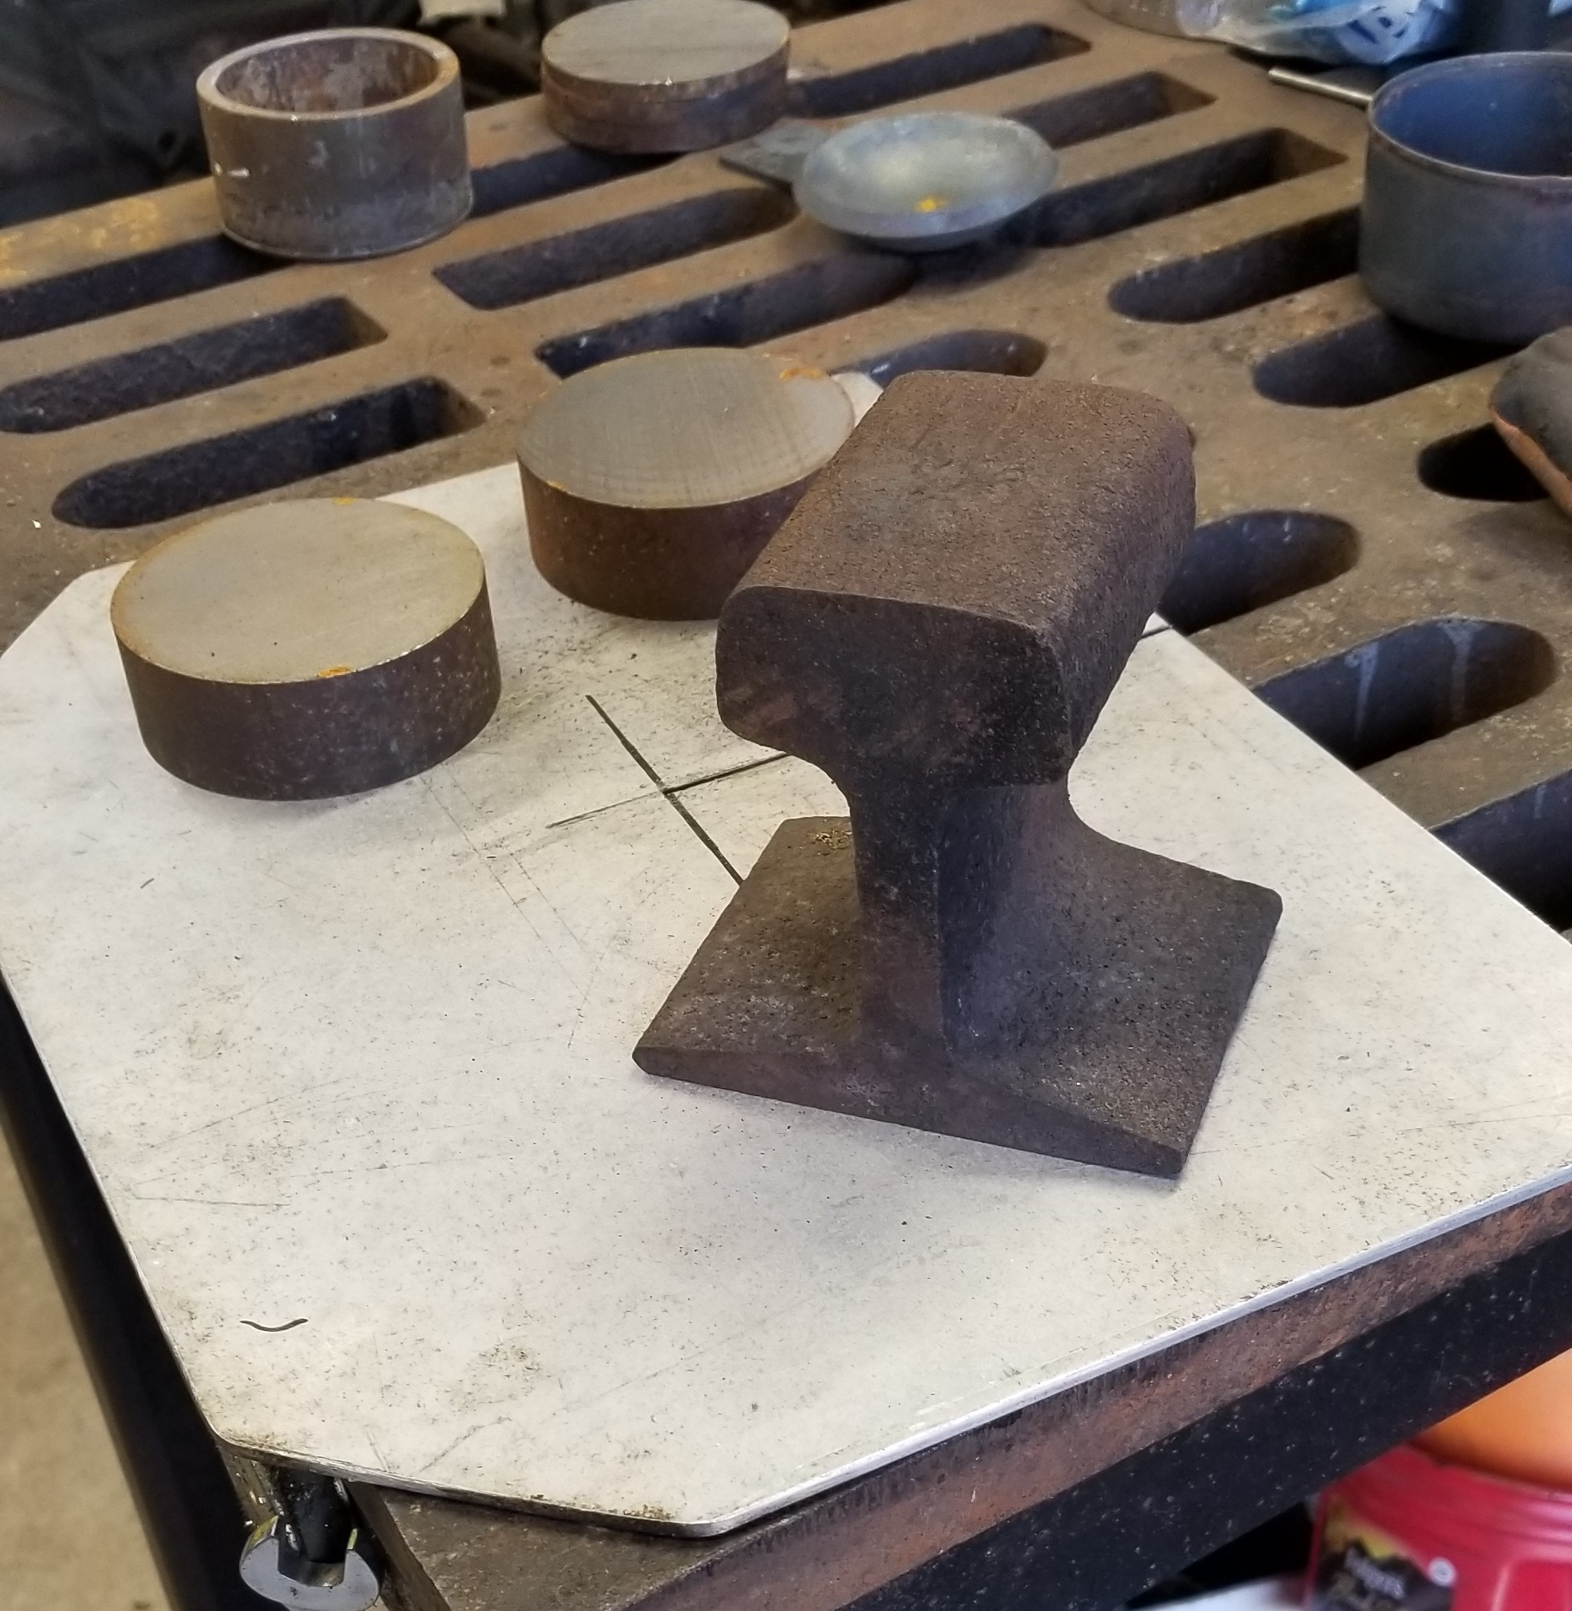
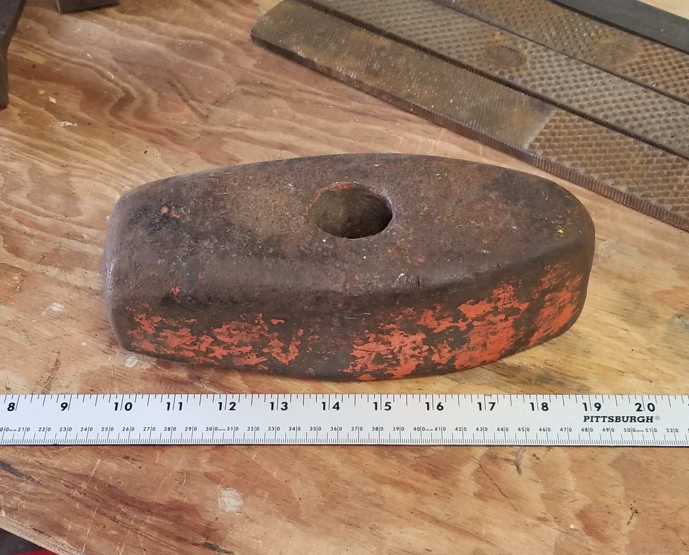

Slide 18
Forging and Temperature
Forging is the act of shaping metal with kinetic energy (tools and muscle)
Heating steel to above it’s critical temperature (~1,350ºF) changes the crystalline structure of steel making it malleable. A plastic state called austenite. Non-magnetic.
Forging is typically done between 1,650ºF to 1,975ºF
As temperature drops the steel begins to harden and stresses develop. Forging at too low a temperature can crack or break the steel.
Heating the steel above 2,000ºF can reduced the carbon content if held too long. Above 2,300ºF (dazzling white) the steel will begin to spark and burn.

Slide 19
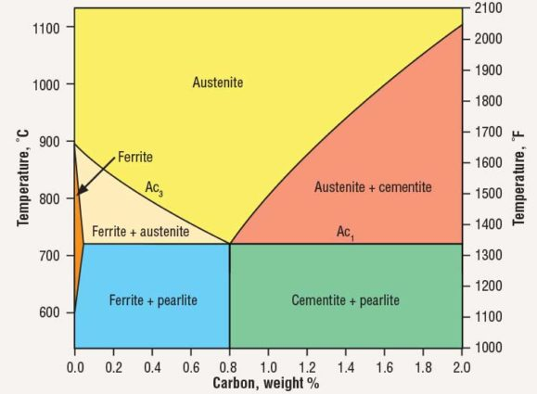

Slide 20
Forging - Moving Metal
Forging is fast.
Temperatures drop quickly. Be ready. Strike while the iron is hot.
The greater the mass the longer it stays hot.
But also radiates more heat making it more difficult to work
Moving metal by forging is physical and mechanical
Hammers have different profiles to achieve different results
Possibilities are nearly endless

Slide 21
Forging - Color of Heat
Blacksmith shops are dark for a reason
Peaceful
Adds to the mystery. Almost mystical.
Temperature is determined by color of the steel.
Inexact but close enough
Everyone’s eyes are different
Experience teaches

Slide 22
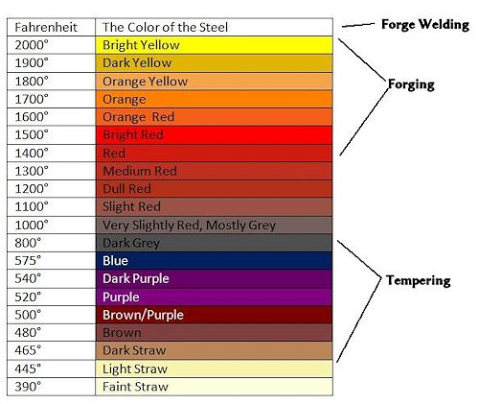

Slide 23
Heat Treatment
Forging is violent
High temperatures
Hammering, twisting, bending….
The object being made takes on numerous stresses which must be relieved to avoid fracture.
At the same we want to create a hard, ductile tool that will withstand hard use. A chisel for example.
The process to relieve the stresses and develop a finished tool is called Heat Treatment

Slide 24
Heat Treatment - Annealing
To relive all the stresses the object must be annealed or normalized to a relaxed molecular state.
The tool is slowly heated to above the critical temperature (non-magnetic) then allowed to cool very slowly (in a dying fire, still air, insulated enclosure).
This may be done 2 or 3 times to ensure the tool is fully annealed.
A metal nirvana.
Good time to do any necessary filing or grinding.

Slide 25
Heat Treatment - Hardening
After annealing the tool is free of stresses but is too soft to do any work and must be hardened.
Next step is to heat it up again above the critical temperature and the cool rapidly. Quenching.
Different steels require different quench baths. Brine, water, oil, air. The rapid cooling is violent and must be done properly to avoid cracks and failure.
Following quenching the tool is now ‘glass hard’. A file will skim across it without scratching.
Very hard and very brittle. If dropped it may shatter.
The crystals created (martensite) from rapid cooling are unstable.

Slide 26
Heat Treating – Tempering
Full hardening leaves the tool too brittle for use. It is hard but not tough. The hardness must be relieved in a controlled way.
Tempering reduces hardness (stress) and increases ductility.
The tool is slowly brought to a low heat which changes some of the hard crystals (martensite) to more ductile ferrite and cementite.
Temperatures range from 400ºF to 800^{oF}
It is a slow process and requires patience.

Slide 27
Tempering
Steel is brought to a bright polish.
Heat is slowly applied
Color of the steel changes
The darker the softer, more ductile
By controlling heat distribution areas of hardness and ductility are also controlled.

Slide 28
Forge Welding
By carefully controlling heat and eliminating contaminants, steel parts can be welded together to make one piece out of two or more.
Different types of steel can be joined to utilize the properties of both. Combine strength and hardness with ductility. Reduce cost.
Examples of forge welded common items are chain, axes and tomahawks, knives, Damascus steel, tongs, tools…..

Slide 29
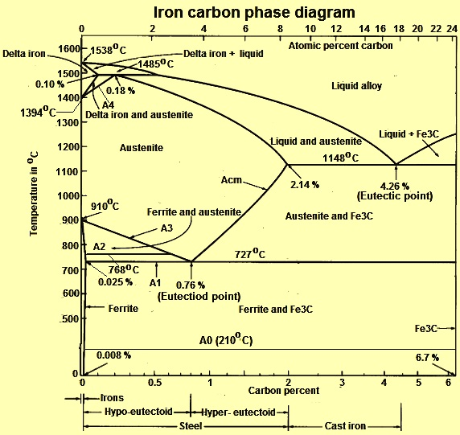
Forge Welding
Above ~2,500ºF steel begins to melt.
If 2 pieces of steel at that temperature touch each other they will stick together
Speed and cleanliness are key. Any debris will weaken the weld.
A flux (Borax) on the mating metals keeps them clean.

Slide 30
Forge Welding
Layers of steel being welded into a larger billet
~2,000ºF

Slide 31
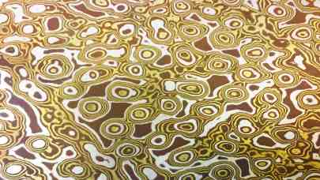
Forge Welding - Damascus and Mokume Gane

Slide 32
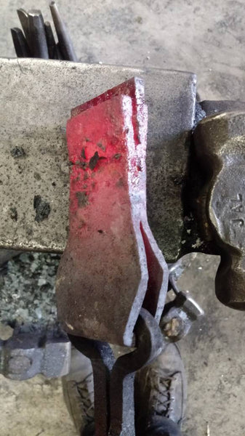
Forge Welded Axe Head
Tool steel blank
Mild steel body

Slide 33
Questions? THANK YOU!

